Slide 1


TTC - Mestrado em Microbiologia APLICADA
IE - MESTRADO EM MATEMÁTICA APLICADA ECONOMIA & GESTÃO
ITT – Engenharia Biomédica e Biofísica
IE - OPCIONAL PARA 2º CICLO
FCUL – 2018/2019
AULA 3
18 Março 2019
Helena Vieira
Copyright ©

Slide 2
Sumário
Inovação e o processo de desenvolvimento de novos produtos. O processo from bench to market.
Alex Osterwalder e o Business Model Canvas – o Método e as diferentes parcelas. Hipóteses e Testes.
O Cliente, o Utilizador e o Influenciador.
Desenvolvimento de Clientes
A Competição.

Slide 3
INNOVATION
Innovation is people creating value by implementing new ideas
Innovation is something different that has impact
Innovation concerns the search for and the discovery, experimentation, development, imitation and adoption of new products, new processes and new organizational set ups
Innovation is the conversion of knowledge and ideas into a benefit, which may be for commercial use or for the public good; the benefit may be new or improved products, processes or services

Slide 4
INNOVATION
INNOVATION is NOT TECHNOLOGY BASED
INNOVATION ≠ CREATIVITY
INNOVATION ≠ NOT BEEN DONE BEFORE!

Slide 5
INVENTION VS INNOVATION
WHAT IS THE MAIN DIFFERENCE?

Slide 6
INVENTION
A system of intertwined pieces of metal that is joined up by another larger metal piece in a successive way, up and down.
An electric pump linked to a suction system can push in objects and small particles from the environment
A system made of aluminum with turns that holds paper
Production of an artificial circular double stranded DNA containing an origin of replication, a polylinker and an antibiotic resistant gene
An aluminum foil covered capsule for moisture and humidity tightness for coffee storage.
Isolation of a fluorescent protein form a water mollusk.

Slide 7
INNOVATION
LEONARDO DA VINCI
VS
THOMAS EDISON

Slide 8
INNOVATION
GENIUSES
Da Vinci – ability to see future, designed & created models that were never implemented in his time (he was a thinker, not a doer!)
Thomas Edison – he implemented his ideas – light bulb; phonograph; motion-picture industry – and they had impact because he was a doer.

Slide 9
INVENTION
A system of intertwined pieces of metal that is joined up by another larger metal piece in a successive way, up and down.
An electric pump linked to a suction system can push in objects and small particles from the environment
A system made of aluminum with turns that holds paper
Production of an artificial circular double stranded DNA containing an origin of replication, a polylinker and an antibiotic resistant gene
An aluminum foil covered capsule for moisture and humidity tightness for coffee storage.
Isolation of a fluorescent protein form a water mollusk.

Slide 10



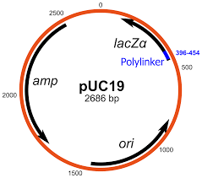
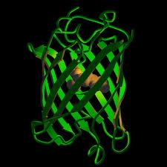
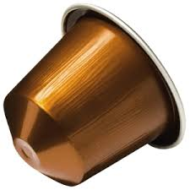
INNOVATION

Slide 11
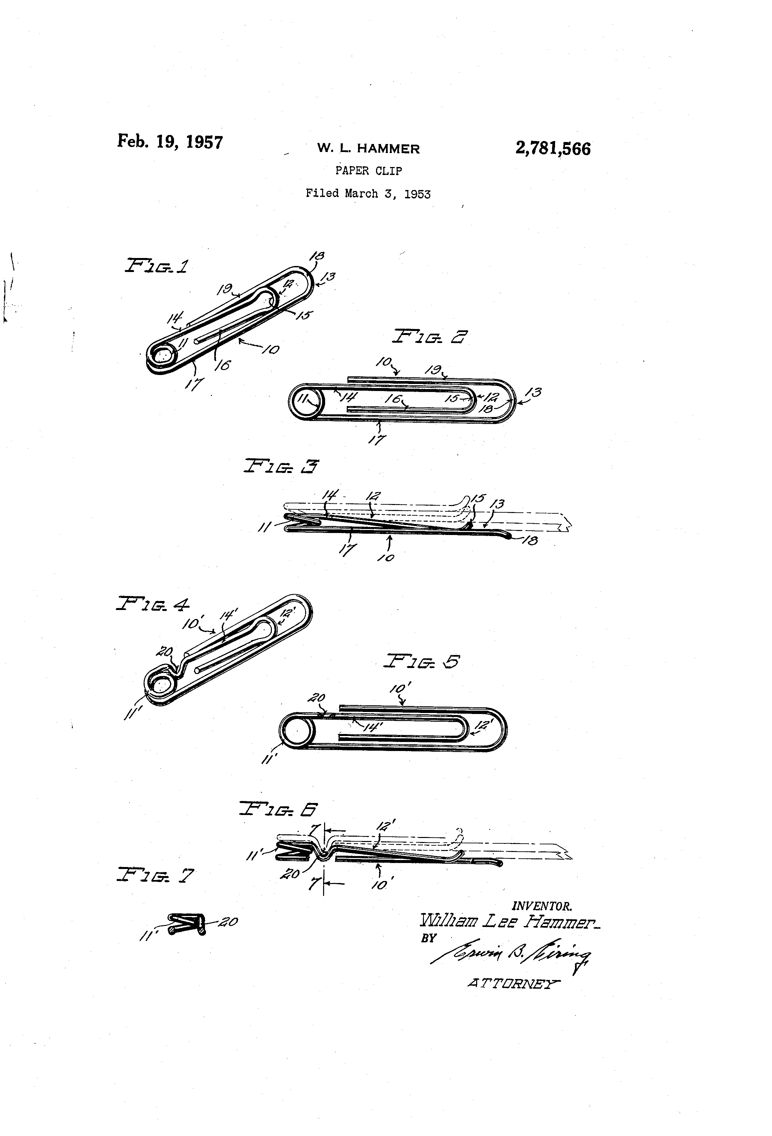
INVENTION

Slide 12
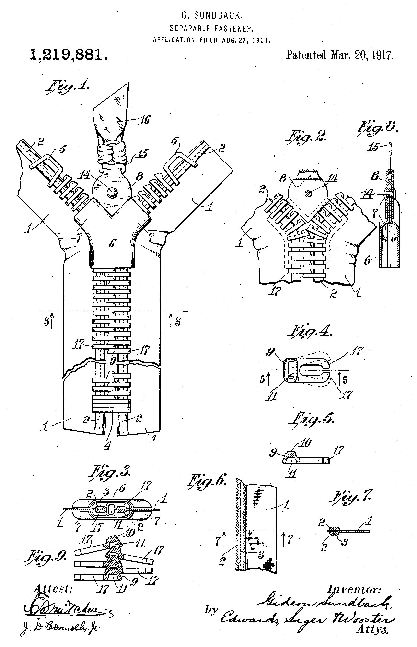
INVENTION

Slide 13
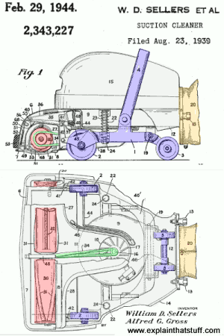
INVENTION

Slide 14
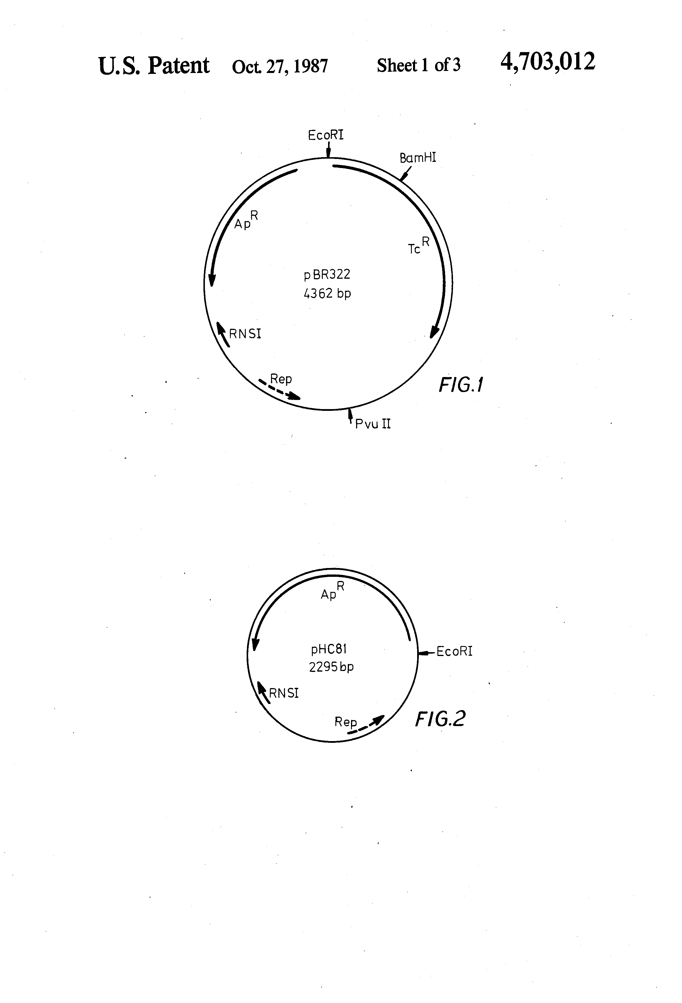
INVENTION

Slide 15
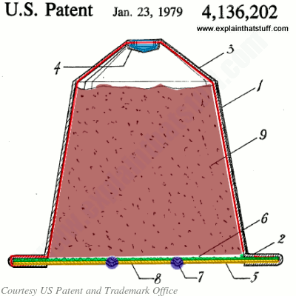
INVENTION

Slide 16

INNOVATING TAKES TIME!

Slide 17
INNOVATION
Incremental innovation seeks to improve the systems that already exist, making them better, faster, cheaper. This is sometimes called "Market Pull" Innovation.
Radical innovation is more focused on new technologies, new business models and breakthrough businesses. This is sometimes called "Technology Push" Innovation

Slide 18
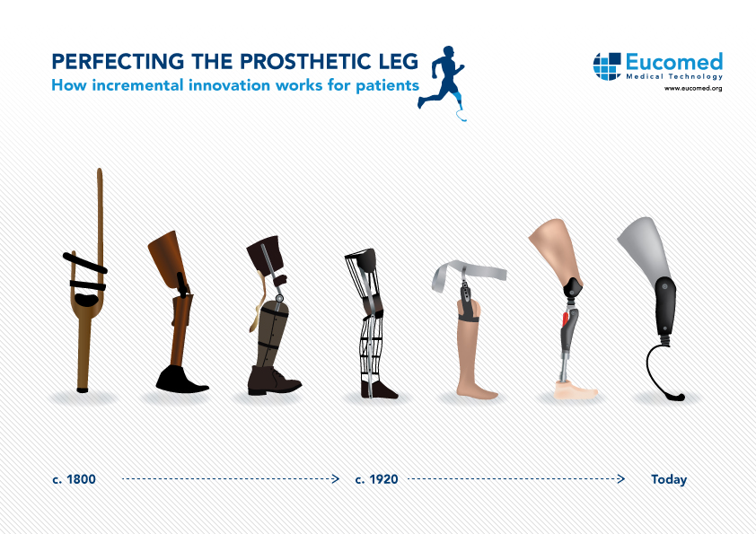

Slide 19
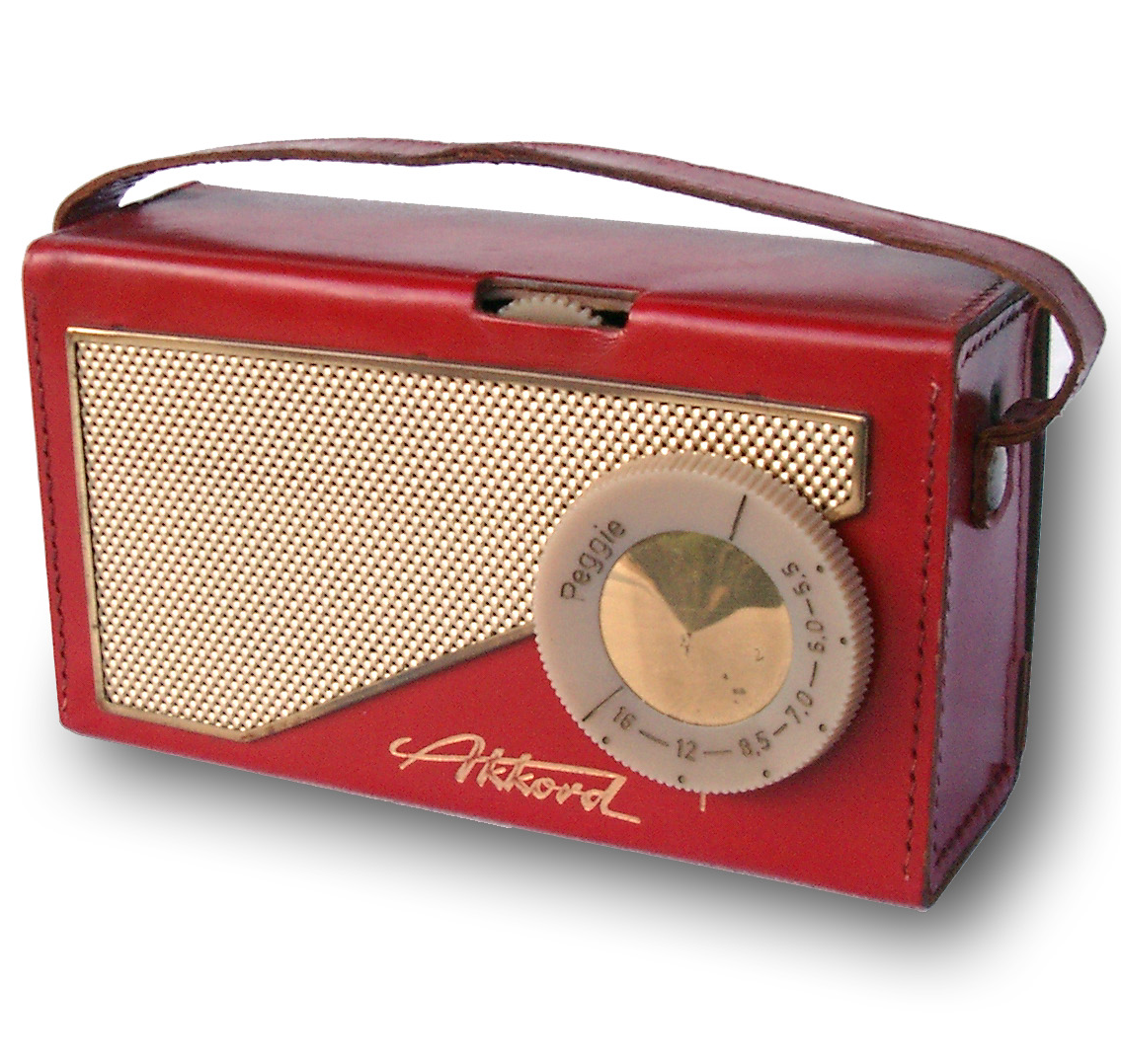
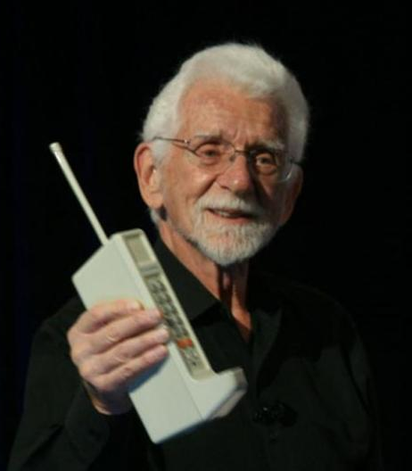
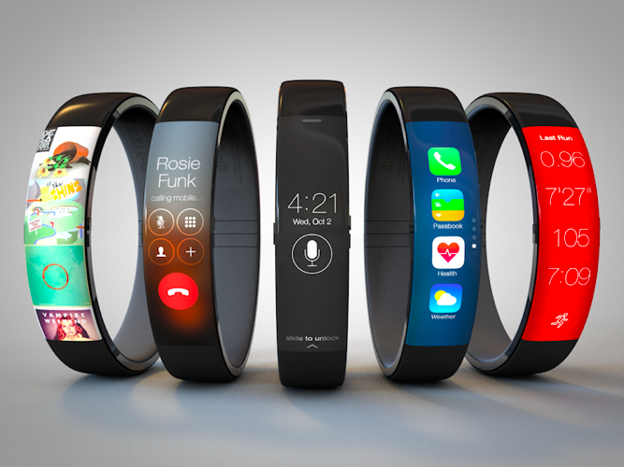
RADICAL INNOVATION

Slide 20
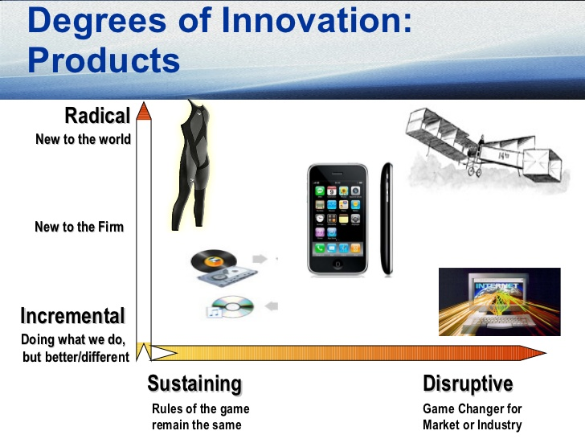

Slide 21
INNOVATION
Open innovation valuable ideas come from inside or outside the company and can go to market from inside or outside the company as well.
Closed innovation valuable ideas for a company come from within this company and go to market from within this same company (centralized R&D).

Slide 22


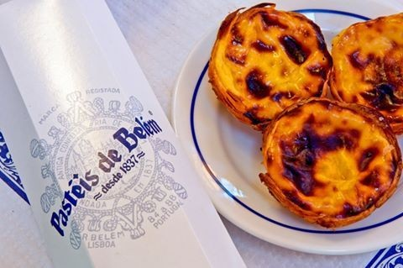
CLOSED INNOVATION

Slide 23
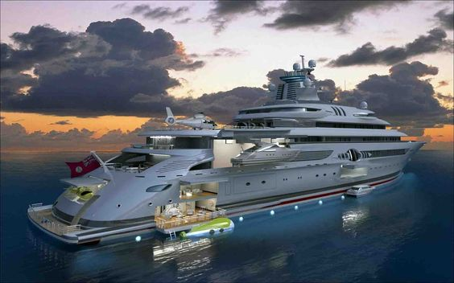


OPEN INNOVATION
Notes:
LEGO - The ‘open’ in open innovation can reveal itself in a number of ways. For example, it can refer to overcoming the “not invented here” syndrome by welcoming external input. Openness is “outside in” when it makes greater use of external brainpower for its innovations. There is also another kind of openness in which a company opens up its ideas and technologies to be used by other companies, even competitors. Lego Mindstorms is a classic example of the “outside in” open innovation model where the company has allowed customers to create designs.
GALP PLUMA – designed by portuguese to the Portuguese

Slide 24

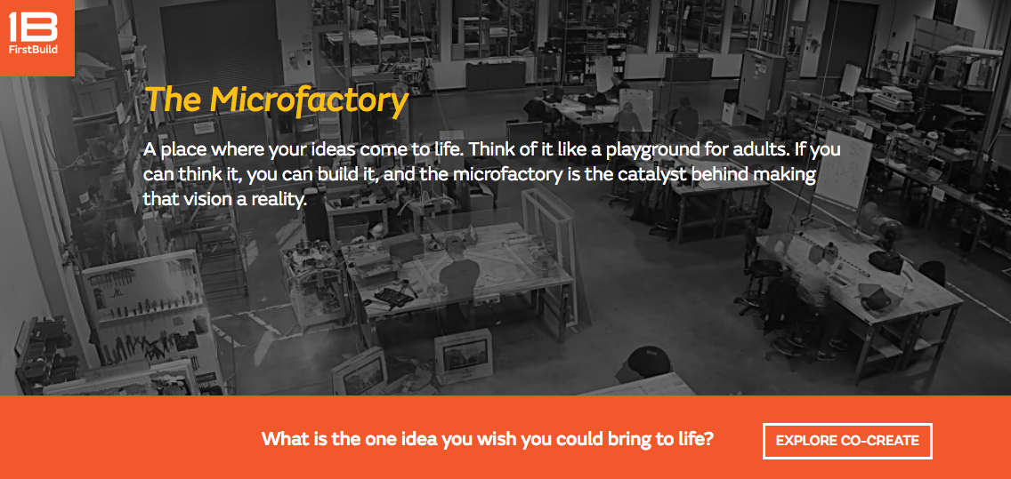
OPEN INNOVATION

Slide 25
INNOVATION
The distinction between "invention" and "innovation" is that invention is the creation of a new idea or concept, and innovation is turning the new concept into commercial success or widespread use
INNOVATION HAS IMPACT!
Source: Yuri Ijuri and Robert Lawrence Kuhn, New Directions in Creative and Innovative Management: Bridging Theory and Practice, Ballinger Publishing (1988).

Slide 26
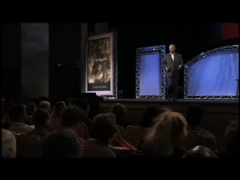
INNOVATION (4)

Slide 27
100 USES EXERCISE
Divide into groups of 5
Each group must in 10 min come up with a list of 100 different uses for the item in their selected card.

Slide 28
TWO BUCKETS EXERCISE
Divide in groups of 3-5
Each group:
Pick a card from bucket A (Brands)
+
Pick a card from bucket B (needs)
Challenge: You work for the company on the A card, and they now require you to develop a product for them that is on the B card.
Notes:
Two Buckets
• Students form teams of three to five. Each
team randomly chooses an index card from
each of two buckets. One set of cards has
major brand names (including international
brands). One set has product categories
(including developing nations’ needs). The
instructor opens with “You work for the
company on the one card, and they now
require you to develop a product for them
that is on the other card.” The groups are
given five to seven minutes to develop
the product’s features, benefits, target
audience, and perhaps promotional ideas.
One spokesperson from each team briefly
presents to the class while the instructor
records their ideas on the board.
• Lesson: Forced association (combining
disparate ideas) is a helpful and practical
way to get ideas for potential innovation,
and a skill that can be developed in
students.

Slide 29

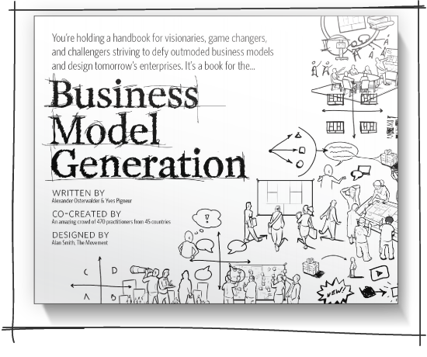
BUSINESS MODEL CANVAS
ALEX OSTERWALDER
http://www.businessmodelgeneration.com/book

Slide 30
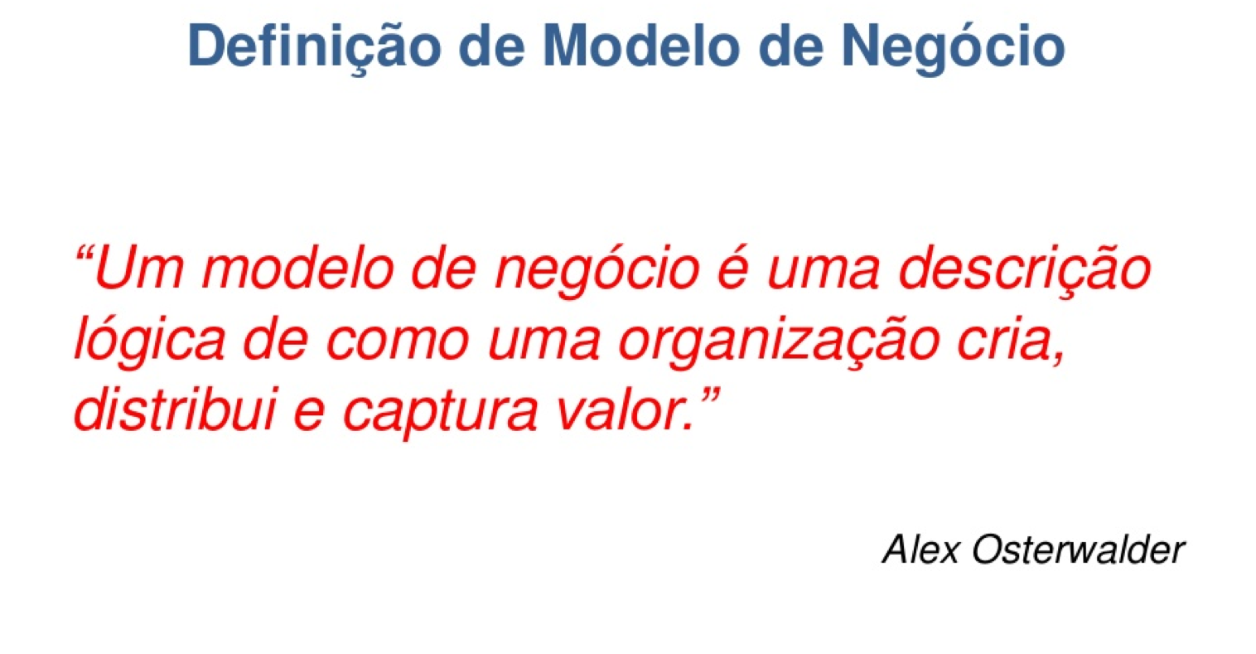
FIXE!! MAS COMO FAZEMOS ISSO?!

Slide 31
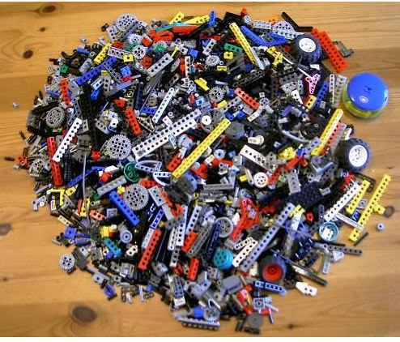
WHY USE A METHODOLOGY?

Slide 32
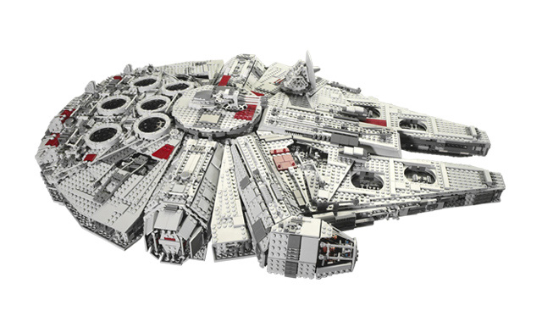
BUILD A STAR WARS SPACE SHIP!

Slide 33
GROUP A

Slide 34
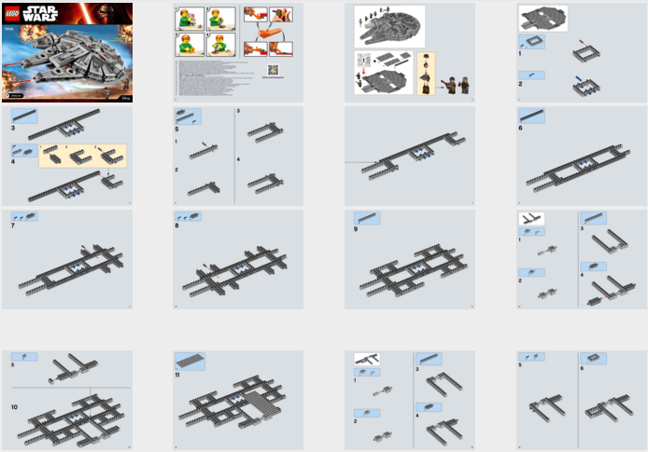
GROUP B

Slide 36
BUSINESS MODEL CANVAS
9 BUILDING BLOCKS

Slide 37
BUSINESS MODEL CANVAS
IT IS USED TO:
DESCRIBE
DESIGN
CHALLENGE
INVENT
INNOVATE!

Slide 38
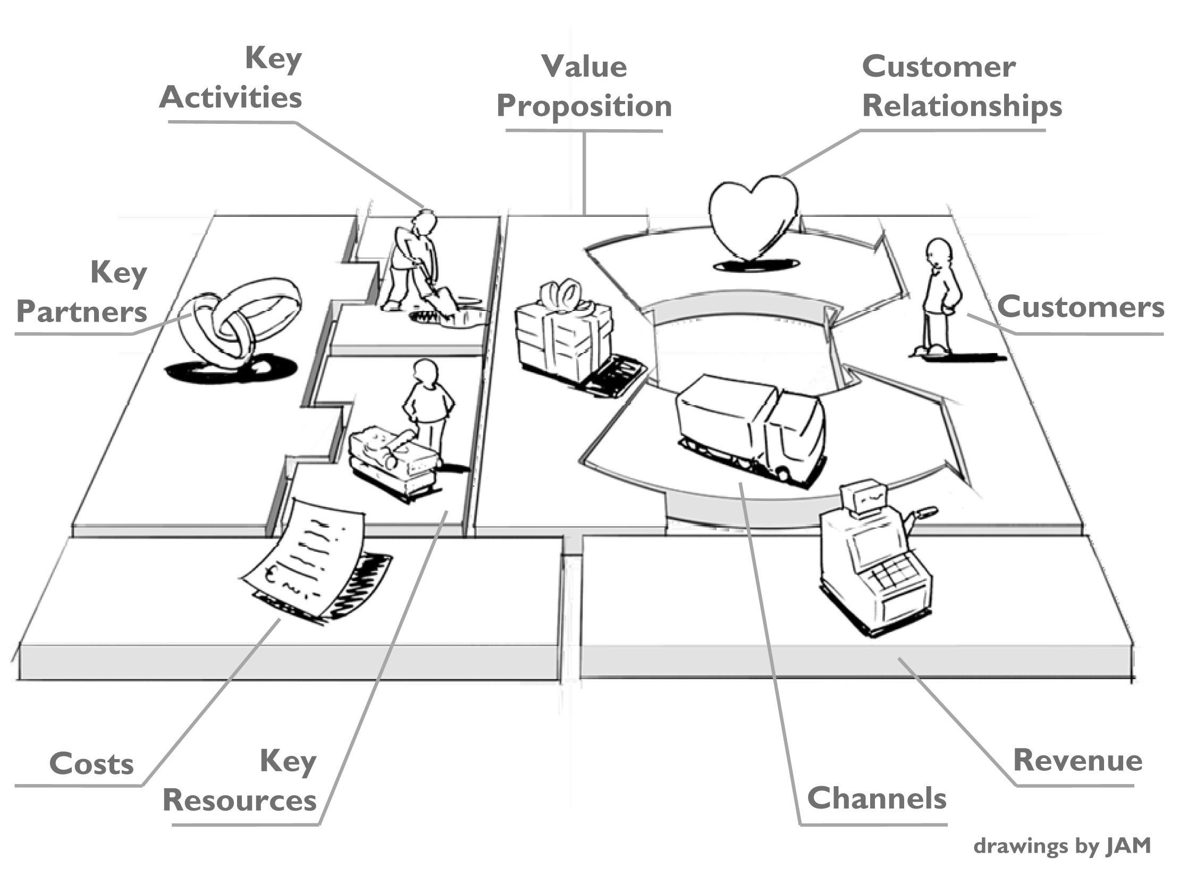
BUSINESS MODEL CANVAS
in: Business Model Generation, Alex Osterwalder & Yves Pigneur, 2009

Slide 39
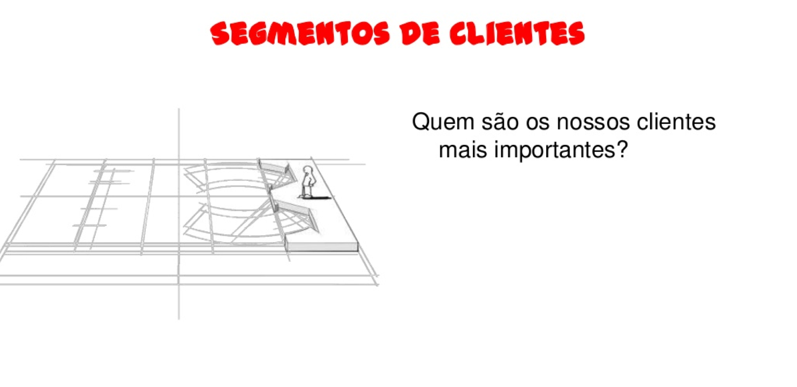
CUSTOMER SEGMENTS
Who are our most important clients?

Slide 40
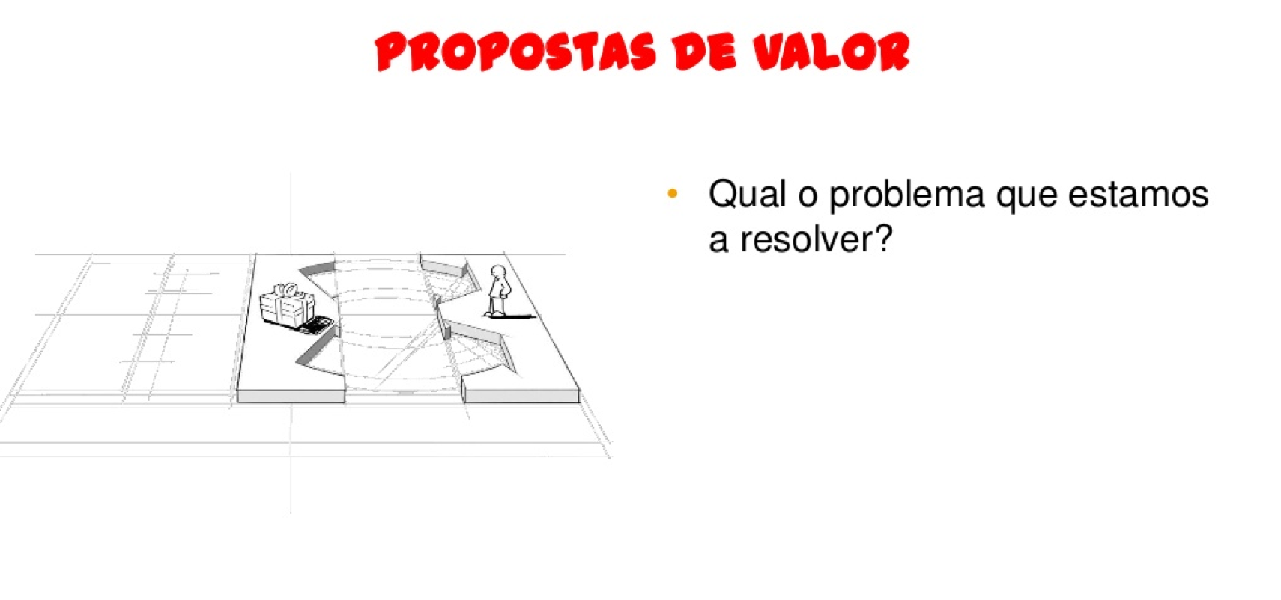
VALUE PROPOSITION
What is the problem we are trying to solve?

Slide 41
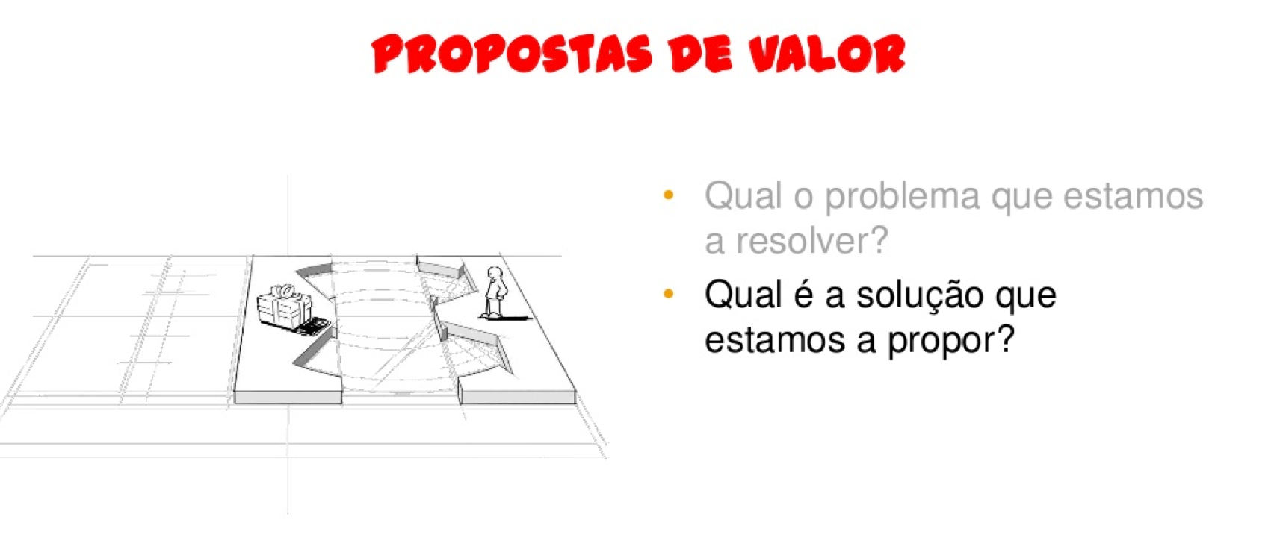
VALUE PROPOSITION
What is the problem we are trying to solve?
What is the solution we are proposing?

Slide 42
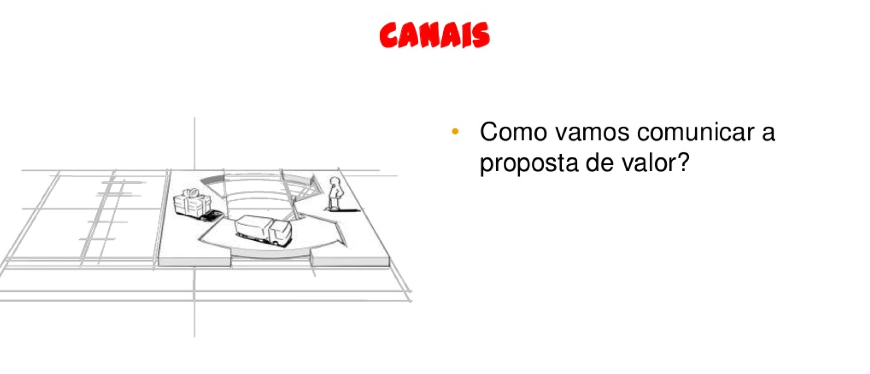
CHANNELS
How are we communicating the Value Proposition?

Slide 43
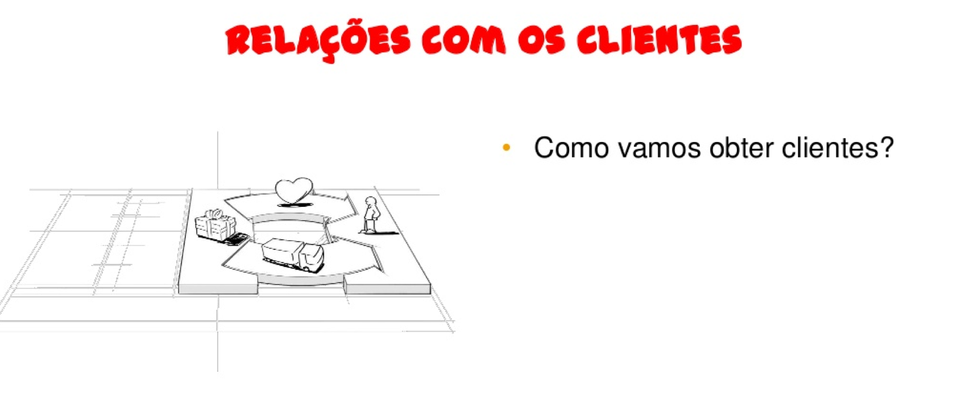
CUSTOMER’S RELATIONS
How will we obtain clients?

Slide 44
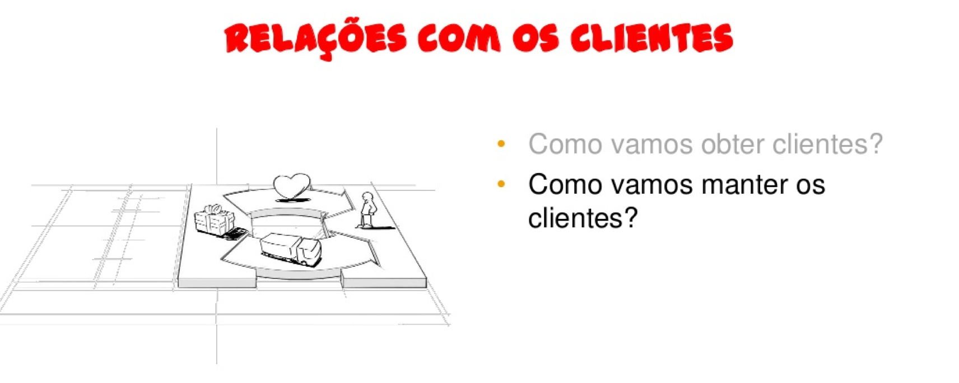
CUSTOMER’S RELATIONS
How will we obtain clients?
How will we maintain clients?

Slide 45
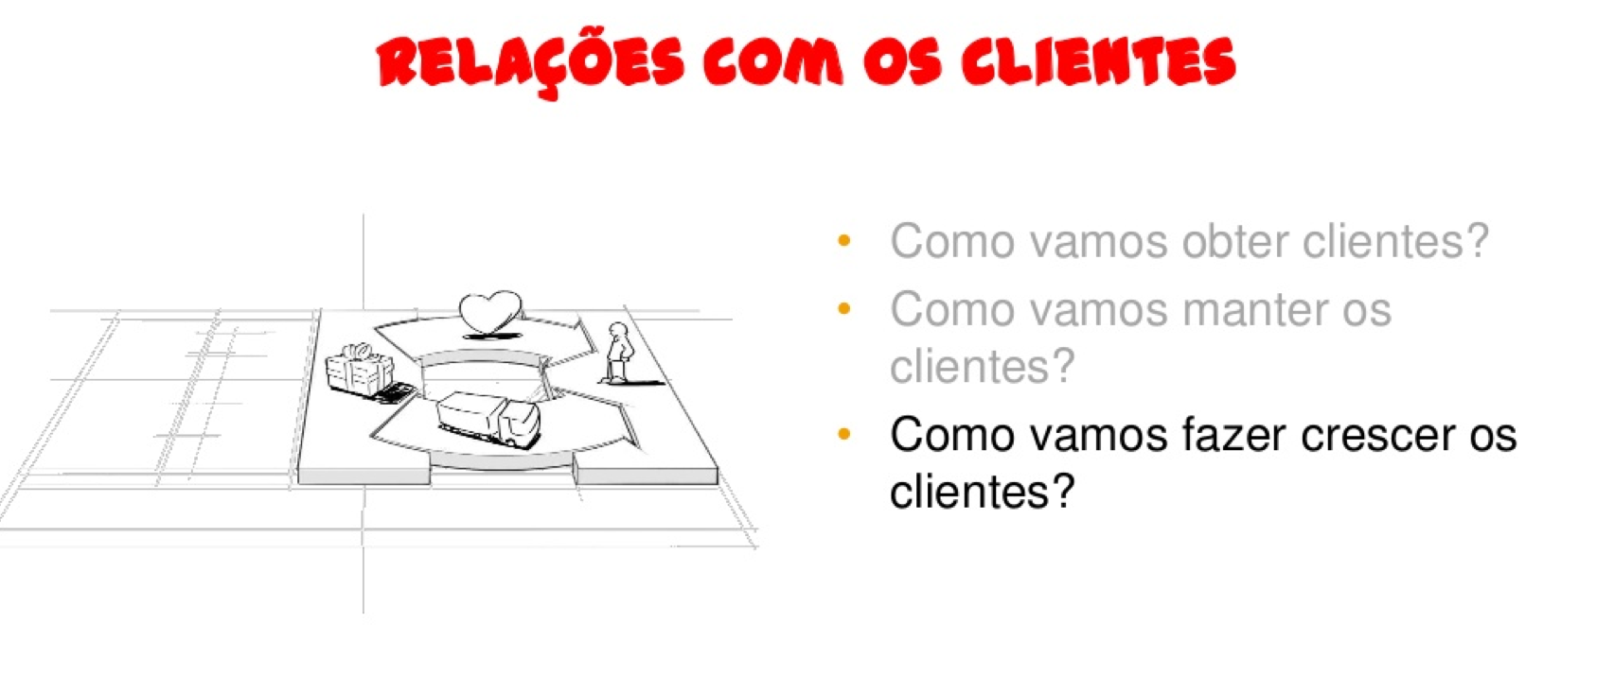
CUSTOMER’S RELATIONS
How will we obtain clients?
How will we maintain clients?
How will we grow clients?

Slide 46
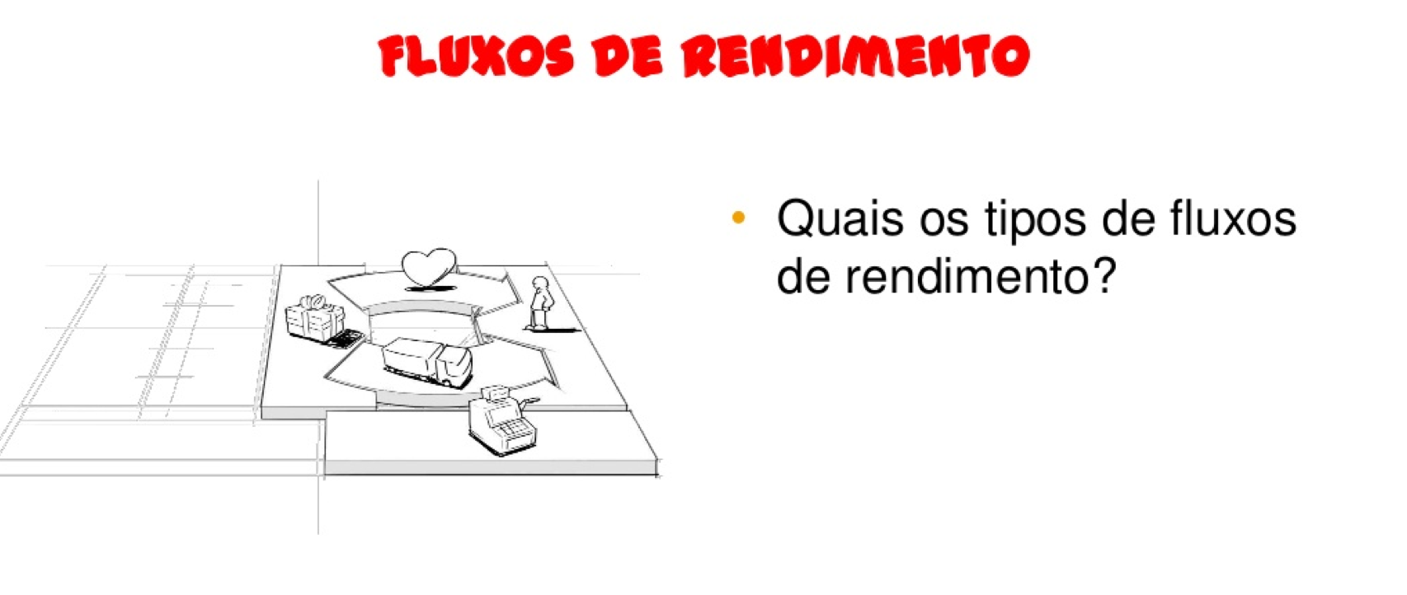
INCOME
What types of income flows can we identify?

Slide 47
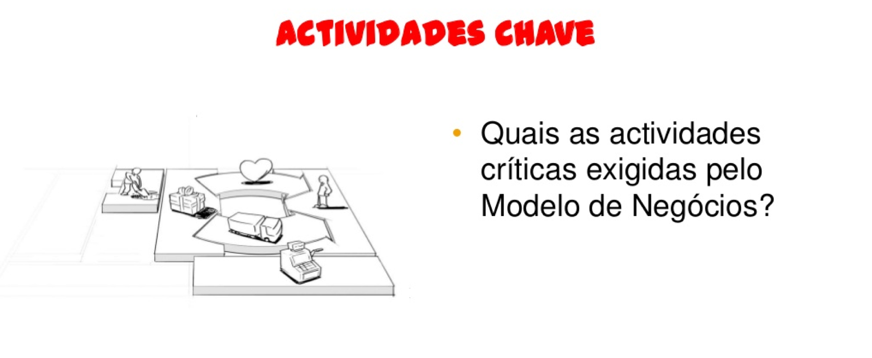
KEY ACTIVITIES
What are the critical activities demanded by my business model?

Slide 48
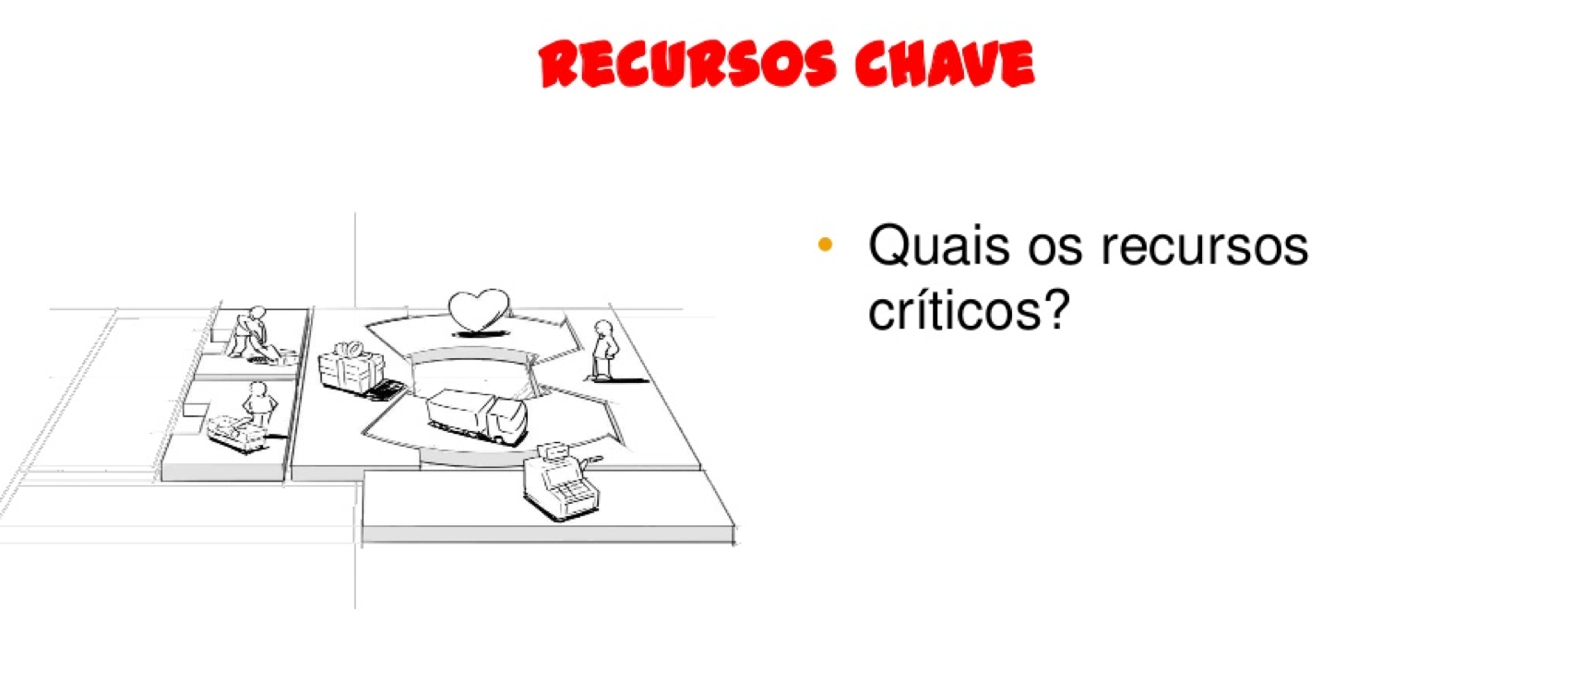
KEY RESOURCES
What are the critical resources demanded by my business model?

Slide 49
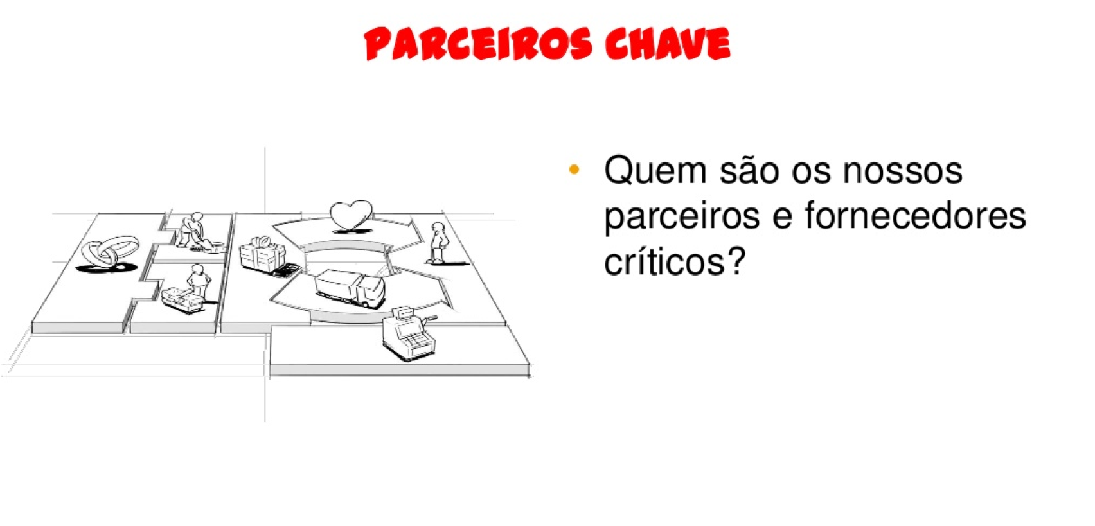
KEY PARTNERS
Who are the critical partners and suppliers of my business?

Slide 50
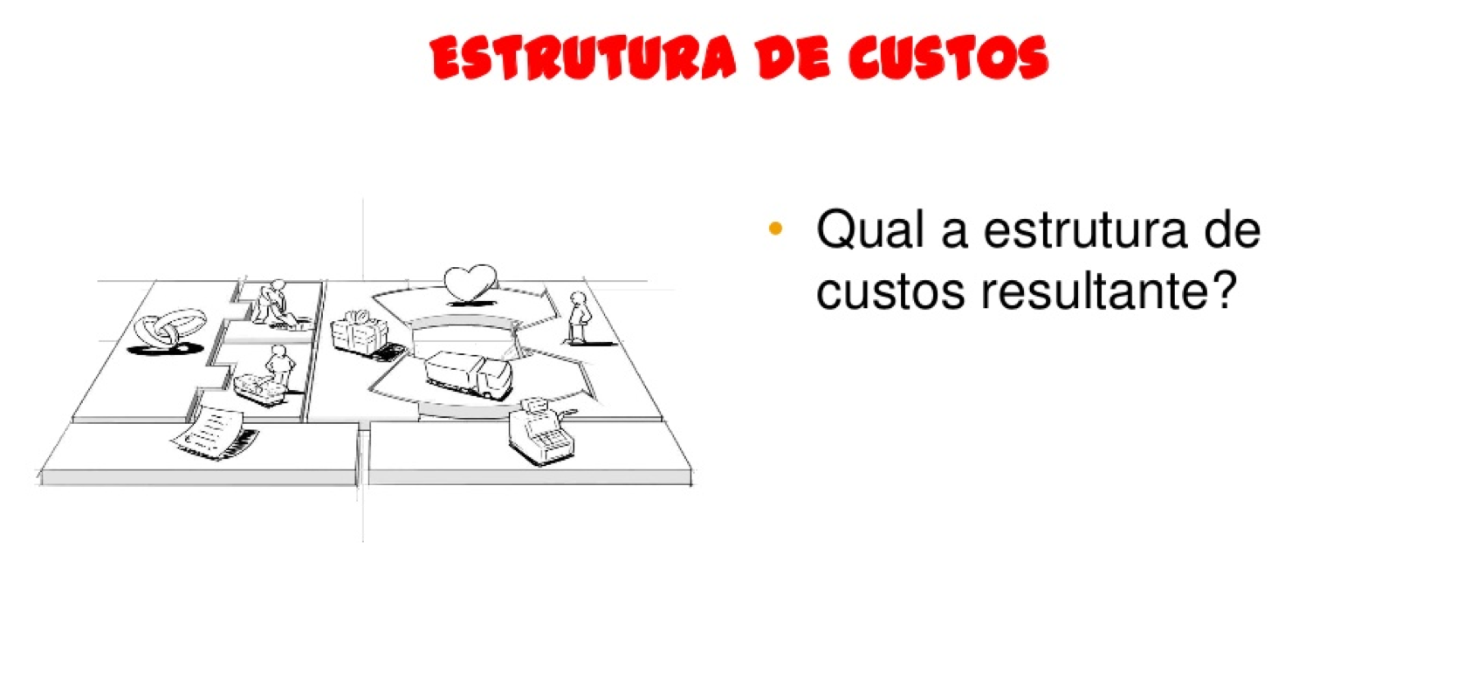
COSTS
What is the resulting cost structure?

Slide 51
BUSINESS MODEL CANVAS
in: Business Model Generation, Alex Osterwalder & Yves Pigneur, 2009

Slide 52
WHAT
HOW
WHO
MONEY

Slide 53
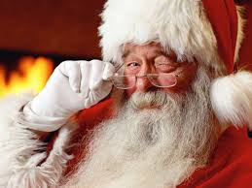

Slide 54
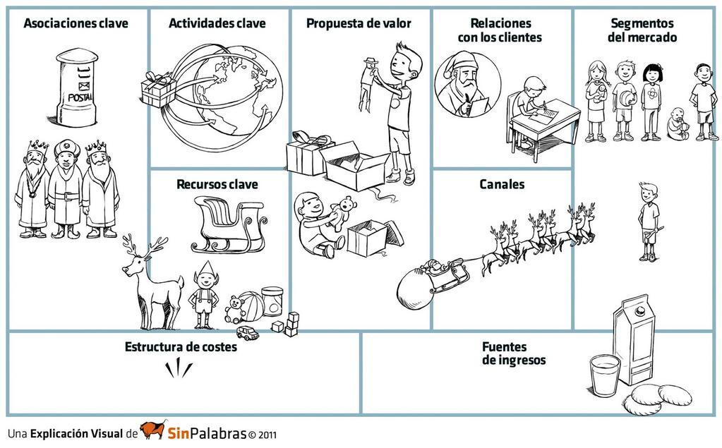
KEY PARTNERS
KEY ACTIVITIES
VP
CUSTOMERS RELATIONSHIP
CUSTOMERS
KEY RESOURCES
CHANNELS
COST STRUCTURE
REVENUE STREAM

Slide 55


Slide 56
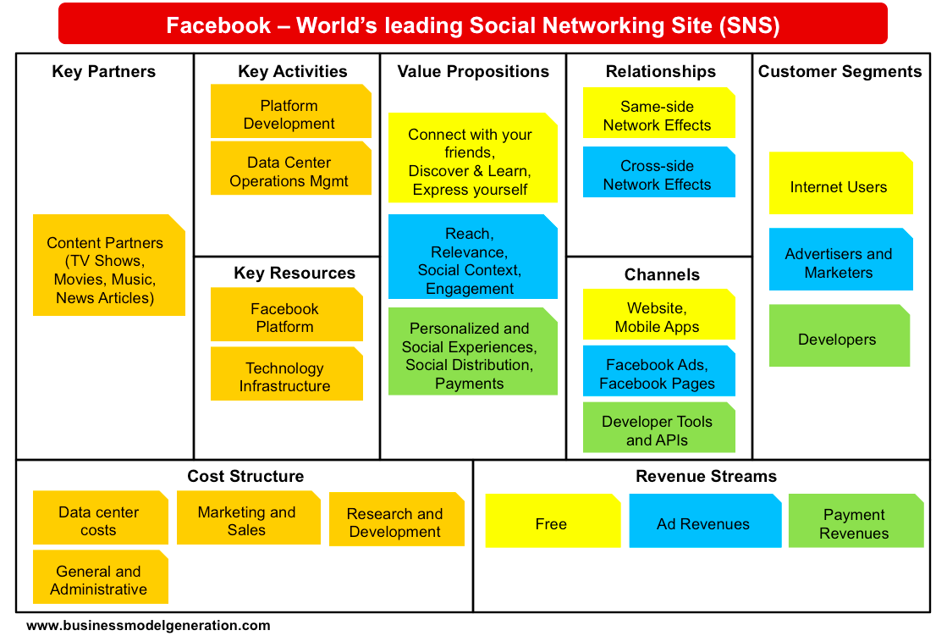

Slide 58
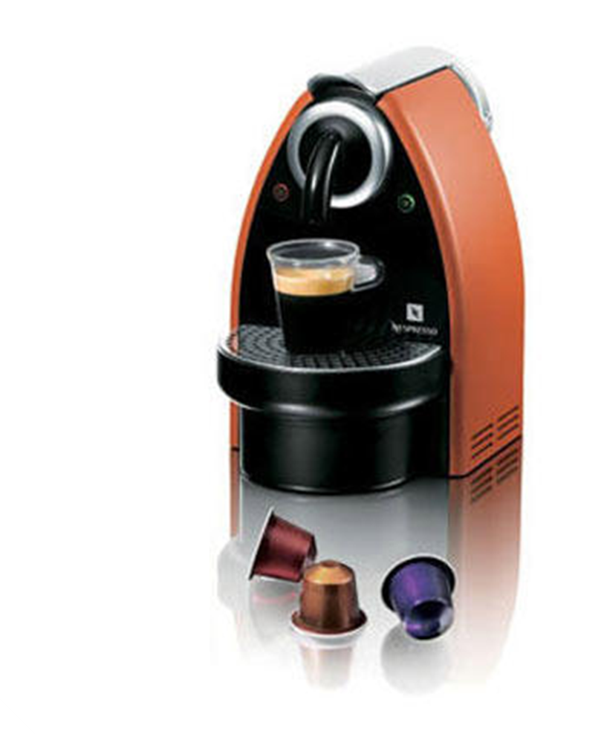
Nespresso altered the business model of expresso coffee

Slide 59
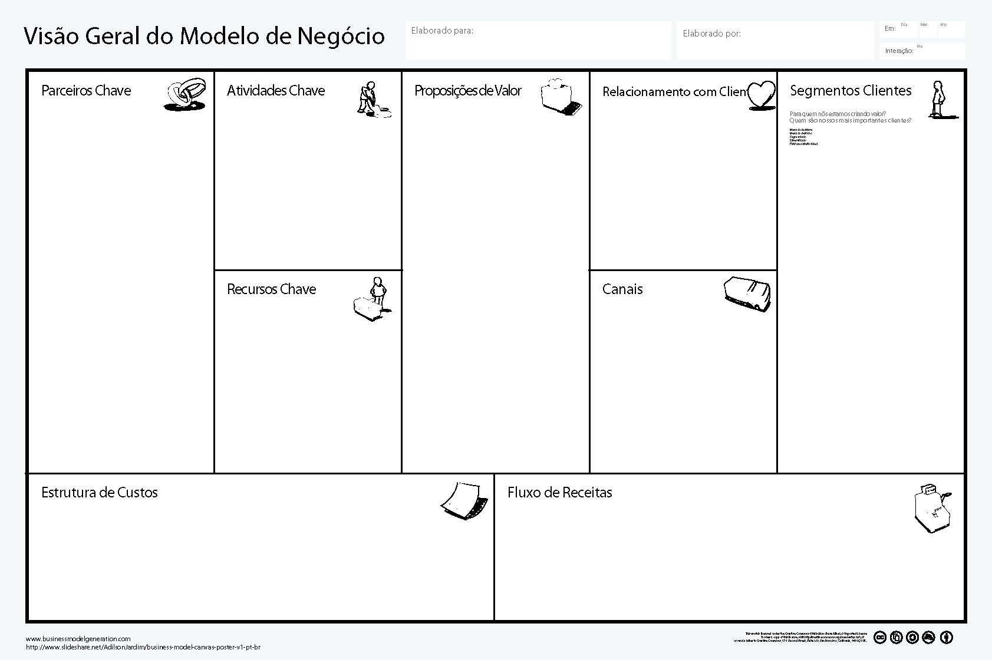

Slide 60

particulares (fãs do Expresso)
empresas

Slide 61
particulares (fãs do Expresso)
Expresso em Casa
empresas
Expresso na Empresa

Slide 62
particulares (fãs do Expresso)
Expresso em Casa
empresas
…lojas de “retail”
Expresso na Empresa
encomenda via correio
Nespresso.com
central telefónica
lojas Nespresso

Slide 63
Clube Nespresso
particulares (fãs do Expresso)
Expresso em Casa
empresas
…lojas de “retail”
Expresso na Empresa
encomenda via correio
Nespresso.com
central telefónica
lojas Nespresso

Slide 64
Clube Nespresso
particulares (fãs do Expresso)
Expresso em Casa
empresas
…lojas de “retail”
Expresso na Empresa
encomenda via correio
Nespresso.com
central telefónica
lojas Nespresso
vendas de maquinas Nespresso
venda de cápsulas Nespresso

Slide 65
distribuição “B2C”
marketing
Clube Nespresso
particulares (fãs do Expresso)
produção
Expresso em Casa
empresas
…lojas de “retail”
Expresso na Empresa
encomenda via correio
Nespresso.com
central telefónica
lojas Nespresso
vendas de maquinas Nespresso
venda de cápsulas Nespresso

Slide 66
distribuição “B2C”
marketing
Clube Nespresso
particulares (fãs do Expresso)
produção
Expresso em Casa
empresas
…lojas de “retail”
Expresso na Empresa
encomenda via correio
canais de distribuição
Nespresso.com
patentes
instalações de produção
central telefónica
lojas Nespresso
vendas de maquinas Nespresso
venda de cápsulas Nespresso

Slide 67
distribuição “B2C”
marketing
Clube Nespresso
particulares (fãs do Expresso)
produção
Expresso em Casa
fabricantes de maquinas de café
empresas
…lojas de “retail”
Expresso na Empresa
encomenda via correio
canais de distribuição
Nespresso.com
patentes
instalações de produção
central telefónica
lojas Nespresso
vendas de maquinas Nespresso
venda de cápsulas Nespresso

Slide 68
distribuição “B2C”
marketing
Clube Nespresso
particulares (fãs do Expresso)
produção
Expresso em Casa
fabricantes de maquinas de café
empresas
…lojas de “retail”
Expresso na Empresa
encomenda via correio
canais de distribuição
Nespresso.com
patentes
instalações de produção
central telefónica
lojas Nespresso
distribuição “B2C”
vendas de maquinas Nespresso
marketing
venda de cápsulas Nespresso
produção

Slide 69


Slide 70
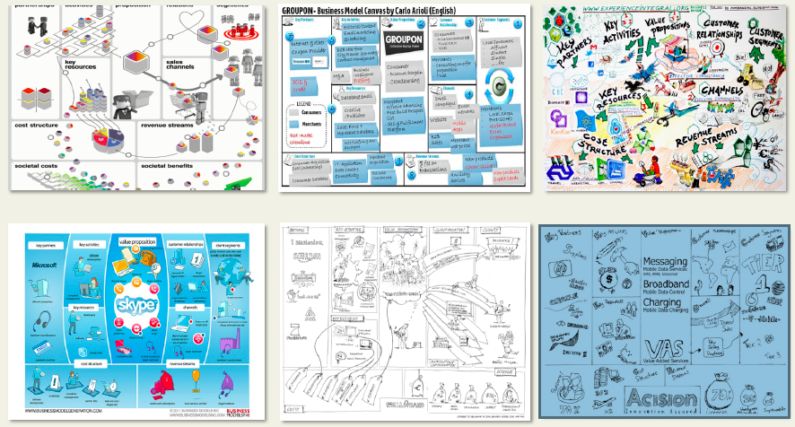
BMC – Universal Language!

Slide 71


Slide 72
BUSINESS MODEL CANVAS
9 BUILDING BLOCKS

Slide 73
1
6
2
4
8
7
3
9
5

Slide 74
BUSINESS MODEL CANVAS
in: Business Model Generation, Alex Osterwalder & Yves Pigneur, 2009

Slide 75
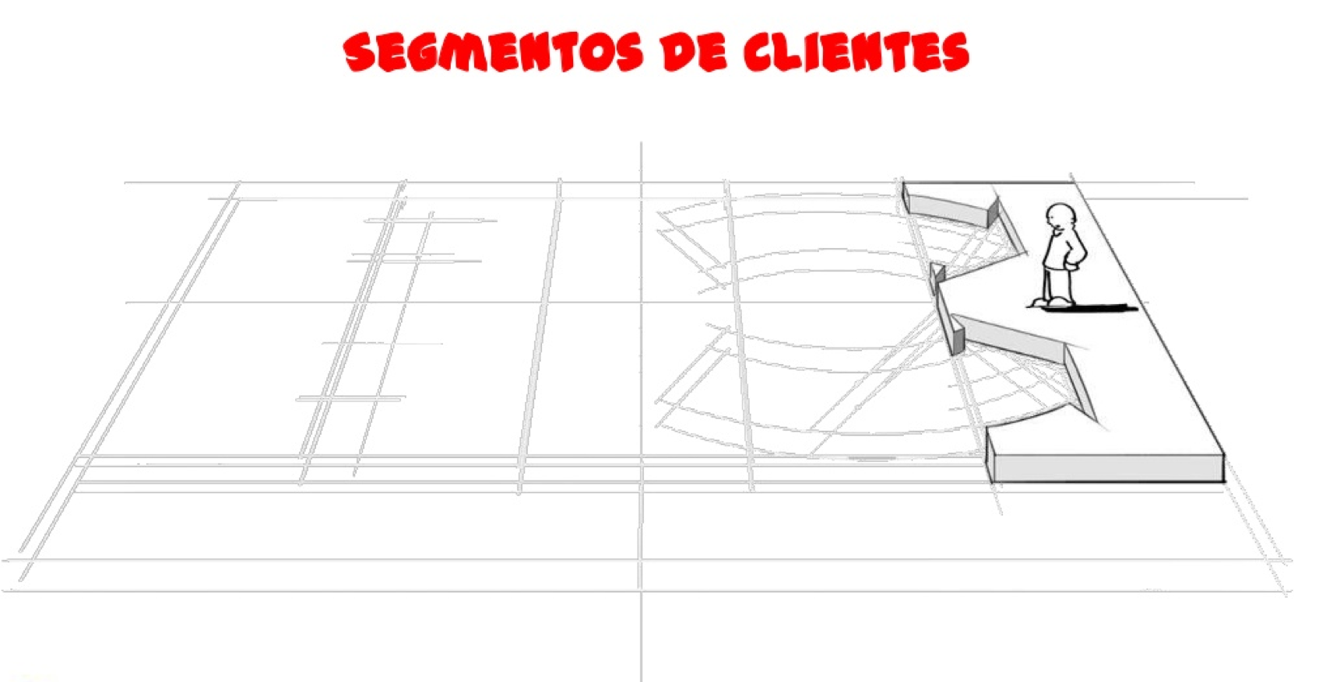
CUSTOMER SEGMENTS

Slide 76
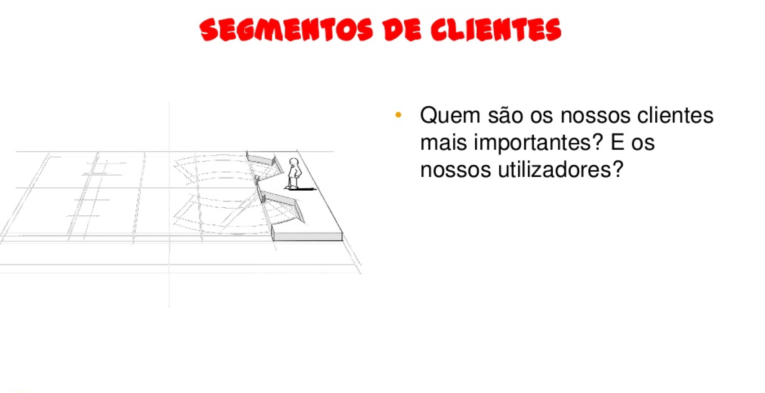
CUSTOMER SEGMENTS
Who are our most important clients?
And our users?

Slide 77
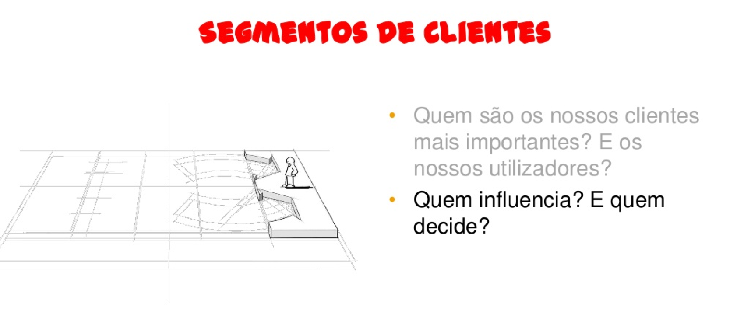
CUSTOMER SEGMENTS
Who are our most important clients?
And our users?
And who influences? And who decides?

Slide 78
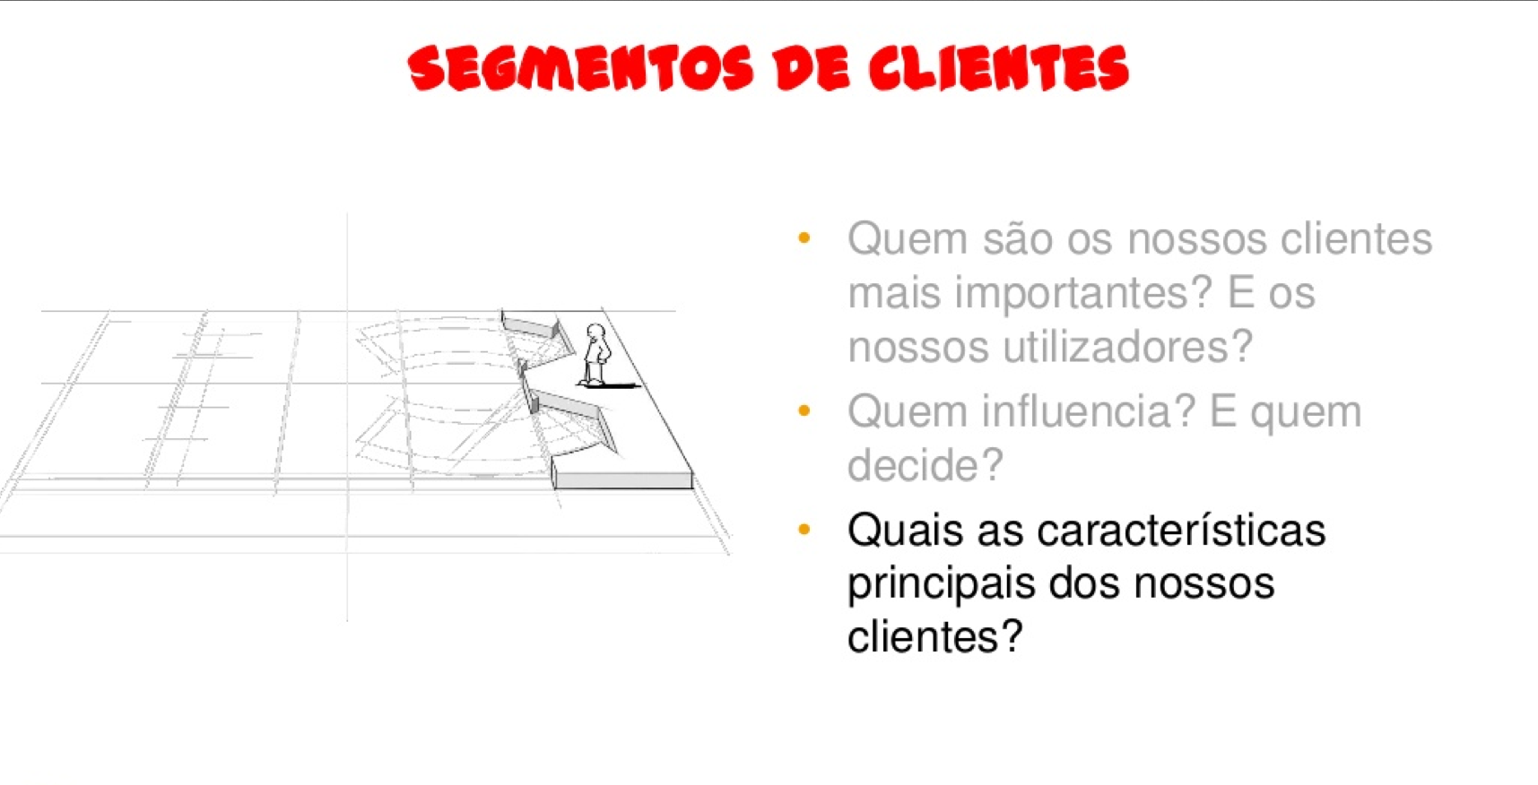
CUSTOMER SEGMENTS
Who are our most important clients?
And our users?
And who influences? And who decides?
What are their most important characteristics?

Slide 79
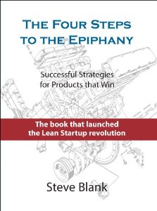
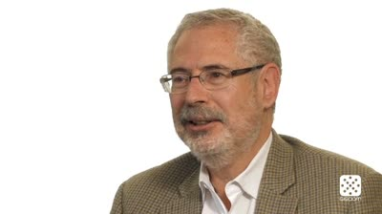
STEVE BLANK

Slide 80
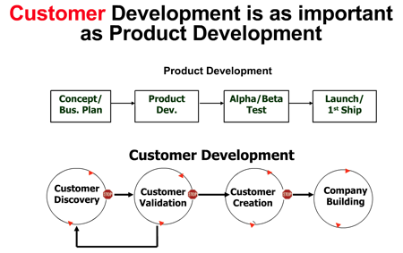
CLIENT DEVELOPMENT
OR WHY 9/10= START-UPs FAIL!!!!

Slide 81
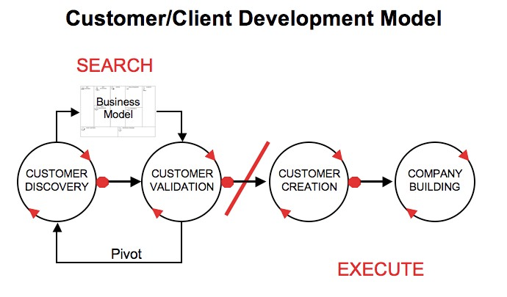
CLIENT DEVELOPMENT

Slide 82
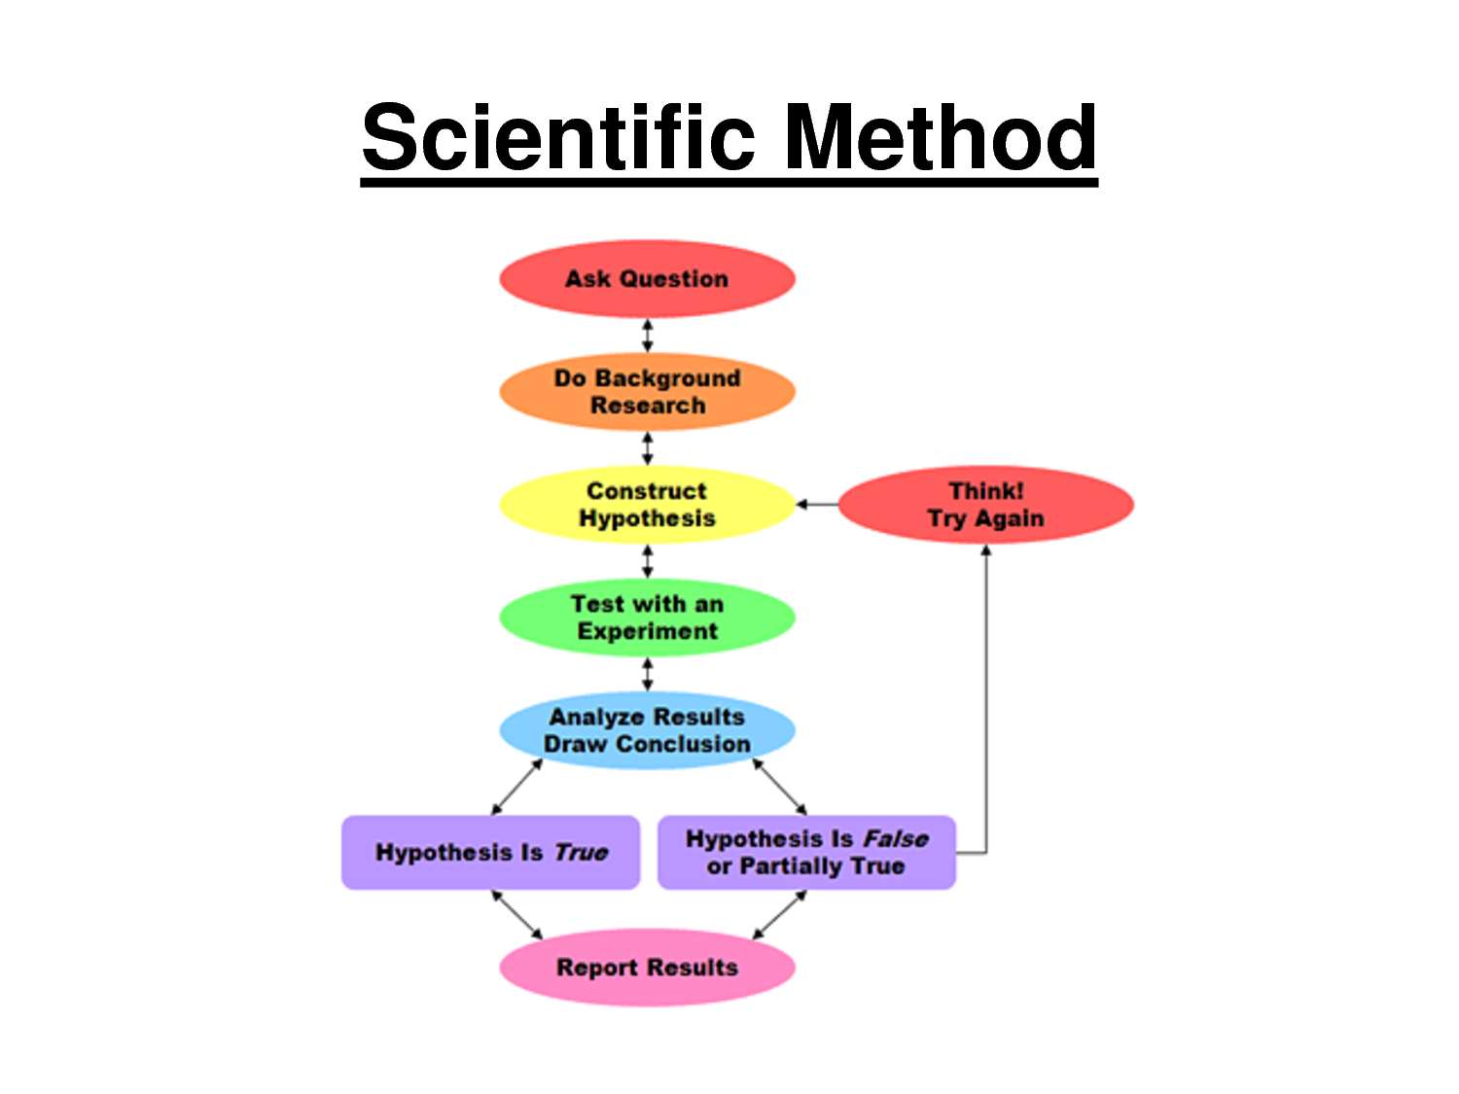
HOW TO TEST?

Slide 83
TESTS
INTERVIEWS
FORMS
A/B TESTING
WEBSITE
SALES DOOR-TO-DOOR
CROWDFUNDING
E-COMMERCE MULTISTORES

Slide 84


Slide 85


Slide 86


Slide 87


Slide 88


Slide 89

HOW TO DEFINE PRIORITY?

Slide 90


Slide 91

BUSINESS MODEL CANVAS
in: Business Model Generation, Alex Osterwalder & Yves Pigneur, 2009

